Slide 1
SQL Server Security
For Everyone
Starting with a good foundation
Kenneth Fisher, Sr. DBA, Aegon

Slide 2
    Kenneth Fisher
@sqlstudent144
sqlstudent144@gmail.com
www.sqlstudies.com

Slide 3


Please silence
cell phones

Slide 4


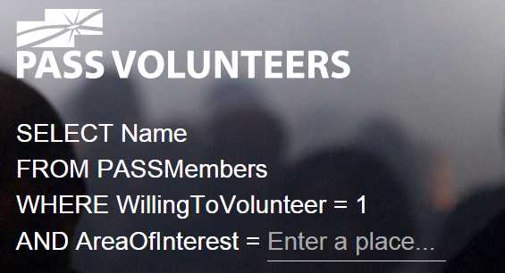






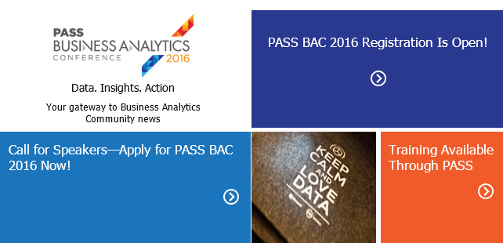


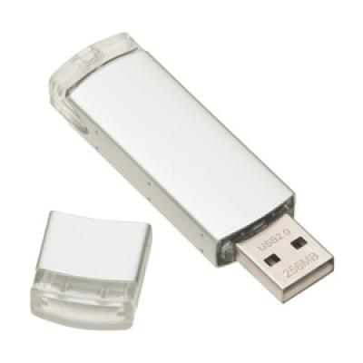
Explore Everything PASS Has to Offer
FREE ONLINE WEBINAR EVENTS
FREE 1-DAY LOCAL TRAINING EVENTS
VOLUNTEERING OPPORTUNITIES
LOCAL USER GROUPS
AROUND THE WORLD
ONLINE SPECIAL INTEREST
USER GROUPS
PASS COMMUNITY NEWSLETTER
FREE ONLINE RESOURCES
BUSINESS ANALYTICS TRAINING
BA INSIGHTS NEWSLETTER

Slide 5
Why are we here?
    The challenges of security.
What security isn’t
It's not high profile like HA, DR, and performance tuning.
There is no praise, only blame.
What security is
Typically very complex.
It’s very easy to make mistakes.

Slide 6
Why are we here?
    The importance of security.
Identity theft
More than 10 million victims a year.
Not just financial identity theft but medical as well.
Data breaches
Impossible to accurately know but from one source more than half a billion individual records lost in 2014.

Slide 7
Why are we here?
    Basics sessions are a great way to get started for newer DBAs and a great review for more senior DBAs.
Why basics?
We all start out at the beginning.
It’s important to have a good foundation in any subject.
A large portion of our work revolves around the basics.
We tend to cause ourselves extra work if we don't understand the basics.

Slide 8
What are we doing?
Definitions
What are talking about?
Using the GUI.
Where can we find security in the GUI?
Using the GUI to learn to script.
Some best practices.
Guidelines from some really smart people.

Slide 9
Definitions
Principals
Securables
Permissions

Slide 10
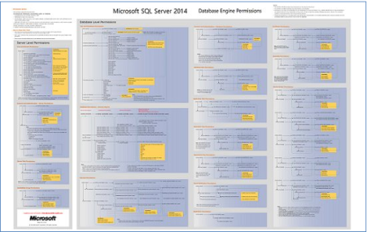
Permissions
    A permission is what the principal is allowed to do to the securable.
Tables & Views
SELECT
INSERT
UPDATE
DELETE
SPs & Functions
EXECUTE
SPs, Functions & Views
VIEW DEFINITION
Databases
CONNECT
BACKUP
CREATE PROCEDURE
VIEW DATABASE STATE

Slide 11
Securables
    A securable is an object that a principal wants access to.
Database
Schema
Schema
Stored Procedure
Function
View
Table
Column
Column

Slide 12
Securables
    A securable is an object that a principal wants access to.
Instance

Slide 13
Principals
    A principal is something requesting permissions to a securable.
Server
Database
SQL login
Server role
Windows login
Login mapped to a certificate
User mapped to an asymmetric key
Windows group
Application role
Login mapped to an asymmetric key
Windows user
SQL user
Windows group
User mapped to a certificate
Database role

Slide 14
Principals
    A principal is something requesting permissions to a securable.
Server
Database
Logins
Users
SQL login
SQL user
Roles
AD\Windows login
AD\Windows login
Server role
Database role
AD\Windows group
Application role
AD\Windows group
Login mapped to a certificate
User mapped to a certificate
Login mapped to an asymmetric key
User mapped to an asymmetric key

Slide 15
Principals
    A role is a special type of principal that is designed to contain other principals and transfer permissions to them.
Built in roles
User defined roles
Server and Database level roles that come with SQL Server most of which can’t be granted or denied permissions.
Roles created by a user and can be granted/denied permissions. User defined server roles are new as of SQL Server 2012.

Slide 16
Tying it all together
    Unsurprisingly all of this data is available through system views.
Instance
Database
sys.server_principals
sys.server_permissions
sys.server_role_members
sys.database_principals
sys.database_permissions
sys.database_role_members
These six contain just the core data. There are several more views and functions with a variety of additional information!

Slide 17
Tying it all together
    How are server principals and database principals related?
 | SID
SQL Login | 0x014EA8886B841C4CA1F7ED32489BBF62
AD Login | 0x010500000000000515000000AA70DE8DE24F4D68F572D916EB8C0100
AD Group | 0x010500000000000515000000AA70DE8DE24F4D68F572D91623FF0300
Certificate | 0x01060000000000090100000069EE6684FF55FDC676DE368D07C2C200FE155810
Server
Principals
Principal_ID
Database
Principals
Name
SID

Slide 18
Tying it all together
    Orphaned Users
 | SID
SQL Login | 0x014EA8886B841C4CA1F7ED32489BBF62
AD Login | 0x010500000000000515000000AA70DE8DE24F4D68F572D916EB8C0100
AD Group | 0x010500000000000515000000AA70DE8DE24F4D68F572D91623FF0300
Certificate | 0x01060000000000090100000069EE6684FF55FDC676DE368D07C2C200FE155810
Server
Principals
Database
Principals

Slide 19
Tying it all together
    Orphaned Users – Windows Authenticated
Server A
Server B
CREATE LOGIN [Domain\Dopey] FROM WINDOWS
Logins
Logins
Users
Users

Slide 20
Tying it all together
    Orphaned Users – SQL Authenticated
Server A
Server B
CREATE LOGIN Dopey WITH PASSWORD = 'MyPass';
Logins
Logins
EXEC sp_change_users_login 'auto_fix','DOPEY';
or
ALTER USER Dopey WITH LOGIN = Dopey;
Users
Users

Slide 21
Tying it all together
    Orphaned Users – SQL Authenticated
Server A
Server B
Logins
Logins
EXEC sp_change_users_login 'auto_fix','DOPEY';
or
ALTER USER Dopey WITH LOGIN = Dopey;
Users
Users

Slide 22
Tying it all together
    Orphaned Users – SQL Authenticated
Server A
Server B
Logins
Logins
EXEC sp_change_users_login 'auto_fix','DOPEY';
or
ALTER USER Dopey WITH LOGIN = Dopey;
Users
Users

Slide 23
Tying it all together
    Orphaned Users – SQL Authenticated
Server A
Server B
CREATE LOGIN Dopey WITH PASSWORD = 'MyPass',
SID = 0x014EA8886B841C4CA
1F7ED32489BBF62
Logins
Logins
Users
Users

Slide 24
Tying it all together
    Orphaned Users – Exceptions
Roles
Contained Databases
Server and database roles have no relation to each other.
The database principals in a contained database have all of the information needed to connect to the server and database.
Server A
Server A
Server B
Login
User
<>
Login
User
Roles
Roles

Slide 25
Tying it all together
    How do we apply a permission to a principal?
DENY
GRANT
A permission cannot be allowed.
Allow a permission
REVOKE
Remove a GRANT or DENY.

Slide 26
Administrative Principals and Permissions
    There are six special principals/permissions. These are the super users and deserve special attention.
    Each of these principals and permissions have complete control over their associated securable.
Single User
Role
Permission
Instance
sa
sysadmin
control server
Database
dbo
db_owner
control database

Slide 27
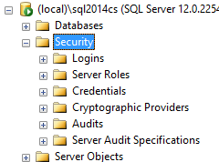
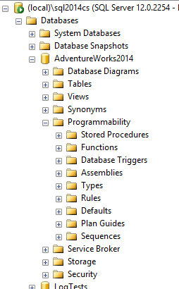
Where can we find everything?
    Most people start out using the GUI to find what permissions a principal has. But where in the GUI is everything?
Principals
Securables

Slide 28
Where can we find security info?
And using SSMS to help us learn to script.

Slide 29
Best Practices!
Least Maintenance
Least Surface Area
Least Privileges

Slide 30
Best Practices!
    Least Maintenance
Make your life as easy as possible.
Don’t make permissions more granular than you have to. (Don’t grant permissions at a table level if granting them at a Schema or even better the database level will work)
Using Roles and AD/Windows groups.
Be consistent.

Slide 31
Best Practices!
    Least Surface Area
Reduce the number of places an attack can come from.
If you don’t need it either disable it (SSIS, SSAS, etc) or don’t install it (external apps, drivers, etc).
Don’t create “extra” databases in production. (AdventureWorks for example)
Disable unused SQL Server Protocols. (TCP\IP, Named Pipes, VIA, shared memory)

Slide 32
Best Practices!
    Least Privilege
If they don't need to do then they shouldn’t be able to.
Don’t add a developer to the db_Owner role, even on a development database.
Grant permissions to views, SPs etc. rather than the underlying tables.
Granting permissions at lowest level possible. (Don’t grant permissions at a database level if granting it at a Schema or even better an Object level will work.)

Slide 33
Best Practices!
    Security is all give and take.
Security is a balance between granting sufficient permissions to allow users to get their job done and limiting those permissions to avoid mistakes and discourage malicious activities.
To make security workable you also have to balance the risks of granting too many permissions against the maintenance cost of granting permissions at the minimum level.

Slide 34
It's a big scary world out there.
Physical Security
Network Security
Social Engineering
Server Security
SQL Server Security

Slide 35




Session Evaluations
ways to access
Your feedback is
important and valuable.
Submit by 5pm
Friday November 6th to
WIN prizes
Go to passSummit.com
Download the GuideBook App and search: PASS Summit 2015
Follow the QR code link displayed on session signage throughout the conference venue and in the program guide

Slide 36
Thank You

Slide 37
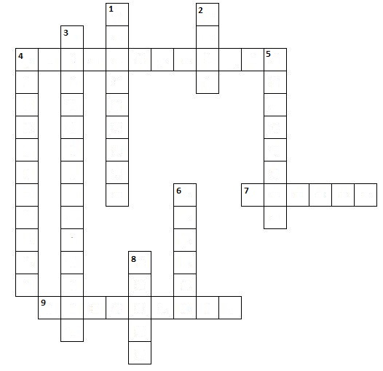
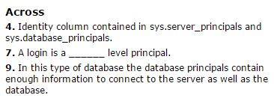
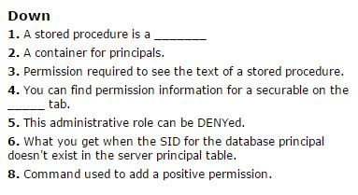
The Quiz!

